Slide 1
Advance Internship@Clevered
Fire Risk Prediction and Alert System
App User Manual
Author: Sivabhargav GV

Slide 2
Table of Contents
Acknowledgements
About Me
About my Internship with Clevered
About App
How to use the app
Options
Contact details

Slide 3
Acknowledgements
I would like to express my sincere gratitude to Clevered, my mentor Mrs. Mani Mehrotra, and Dr Ken for providing me the opportunity and platform to develop new AI skills and learn app development. Their guidance throughout this internship has helped me to complete my project and improve my knowledge regarding real-life applications of coding.
https://www.kaggle.com/code/hasibalmuzdadid/fire-alarm-triggering-analysis-accuracy-100/notebook was the website recommended to me, and I used it as a reference for my project as well as for downloading the large training dataset.

Slide 4

About Me..
My name is Sivabhargav GV,
and I am a class XII student studying in DPS Gurgaon Sector-45. I like to build projects that apply technology to solve practical real-world problems through coding and other AI related tools.

Slide 5
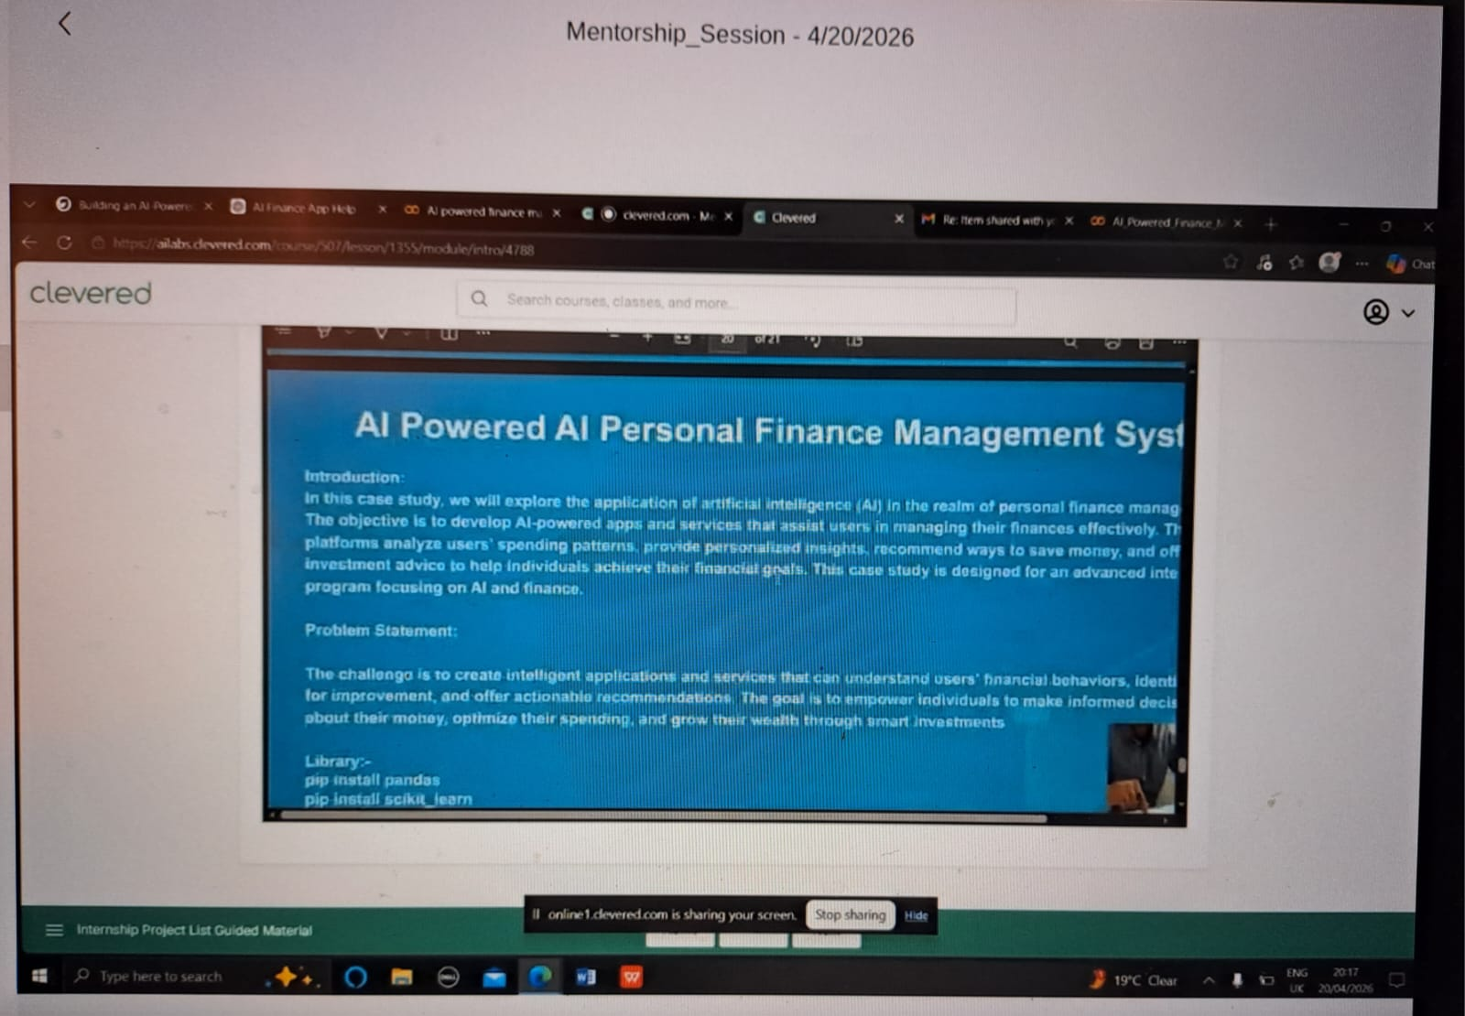
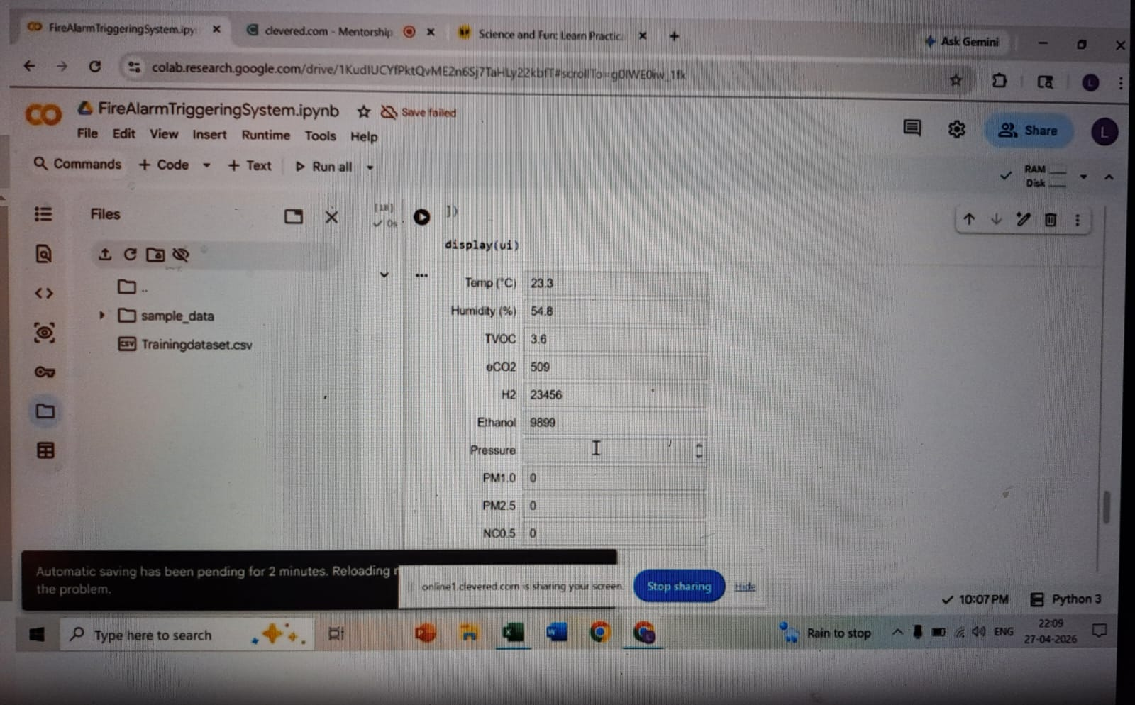
About My Internship with Clevered..
My internship with clevered helped me to understand the practical applications of AI,for example, the use of gTTs feature in python to convert text-to-speech,user interface development using ipywidgets etc.
Throughout this internship, I learned dataset processing, model training, UI development and additional use of python libraries.
I successfully completed the internship project and learning activities conducted by Clevered.

Slide 6
About App..
App’s Main Menu
The main interface of the application contains:
1) Input values for environmental sensor values.
2)Predict Fire Risk button.
3)Output display section.
4)Voice alert system.
App’s Introduction
My app/project uses Random Forest Classifier
Model to analyse parameters such as temperature, pressure, humidity and particulate concentrations. Based on these inputs, the application predicts the fire risk level with audio alerts.

Slide 7
How to use the App?
1) Launch the application.
2)Enter the required sensor values into the input boxes.
3)Click the “Predict Fire Risk” button.
4)Observe the fire risk probability and risk classification.
5)Listen to the generated voice alert.

Slide 8
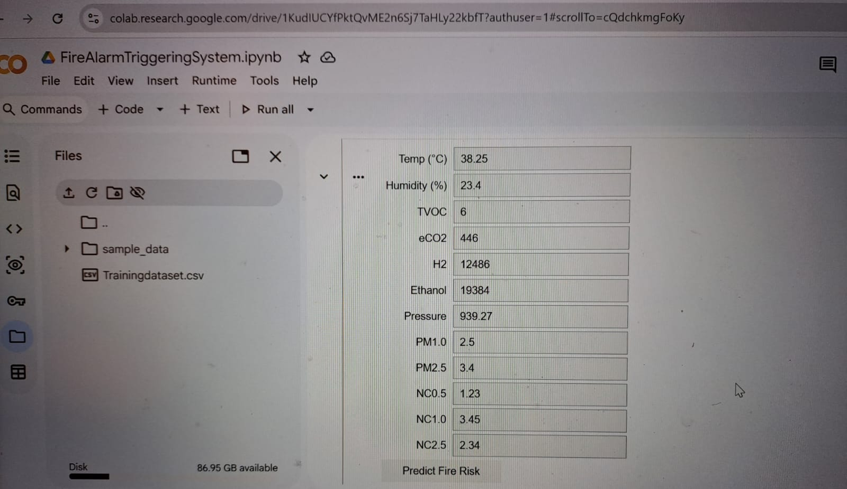

Options
Sensor Input Section
Prediction Output Screen
Here, the user inputs for different parameters.
(Note- Ensure all fields contain valid numerical inputs. )
Thus, the system predicts fire risk and provides both visual and audio alerts based on environmental sensor inputs.

Slide 9
Contact Person
Please reach out to Sivabhargav GV at sivabhargav2008@gmail.com for any questions/ concerns/ suggestions on the App.

Slide 10
Thank you!

